Slide 1
React js LECTURE-7
What is the Folder Structure for React Project?
The folder structure looks like this.
Assets Folder - It consists of images and styling files.
Layouts Folder - We can store the header, footer, or sidebar code here and call it.
Components Folder - UI components like buttons, modals, inputs, loader, etc.
Pages Folder - Each file in this folder contains its route. A page can contain its sub folder.
Middle ware Folder - It is used when we are using reduce with it. Here we keep all our custom middle ware.
Routes Folder - It consists of private, protected, and all types of routes.
Config Folder - we store environment variables
Services Folder - there are 3 folders named actions, reducers, and constant subfolders to manage states. [Redux]
Utils Folder - It should contain only common js functions & objects like dropdown options, regex condition, data formatting, etc.
Notes:
RWn. Senior Faculty Rinkal Adesara

Slide 2
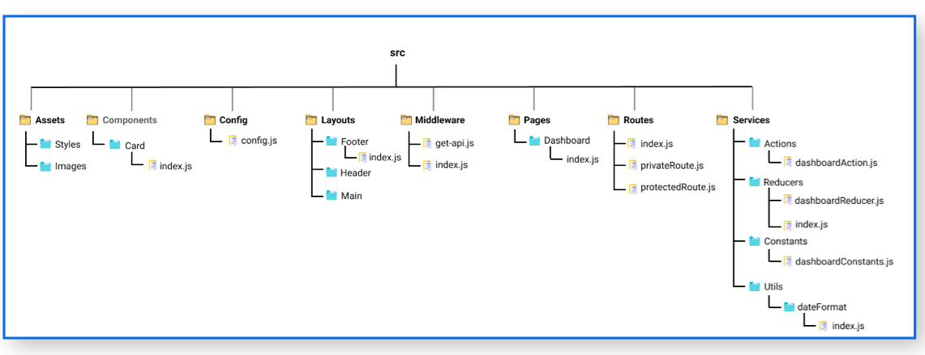
Folder Structure
Notes:
RWn. Senior Faculty Rinkal Adesara

Slide 3
Introduction of jsx
Javascript XML
Ex: const name = “Rinkal” const res = <div>My name is : {name}</div> import React from 'react';
import ReactDOM from 'react-dom';
ReactDOM.render(
res,
document.getElementById("root")
);
Notes:
RWn. Senior Faculty Rinkal Adesara

Slide 4
Nested Elements
import React, { Component } from 'react';
class App extends Component{
render(){
return(
<div>
<h1>Red and White</h1>
<h2>Training Institutes</h2>
<p>This website contains the best CS tutorials.</p>
</div>
);
}
}
export default App;
Notes:
RWn. Senior Faculty Rinkal Adesara

Slide 5
JSX Attributes
JSX uses camelcase naming convention for attributes
class in HTML becomes className in JSX
We can also use our own custom attributes in JSX
For custom attributes, we need to use data- prefix. 1. As String Literals: We can specify the values of attributes in double quotes:
var element = <h2 className = "firstAttribute">Hello JavaTpoint</h2>;
2. As Expressions: We can specify the values of attributes as expressions using curly braces {}:
var element = <h2 className = {varName}>Hello JavaTpoint</h2>;
Notes:
RWn. Senior Faculty Rinkal Adesara

Slide 6
JSX Comments
{/* This is a comment in JSX */}
JSX Styling
import React, { Component } from 'react';
class App extends Component{
render(){
var myStyle = {
fontSize: 80,
fontFamily: 'Courier',
color: '#003300'
}
return (
<div>
<h1 style = {myStyle}>www.redandwhite.com</h1>
</div>
);
}
}
export default App;
Notes:
RWn. Senior Faculty Rinkal Adesara

